Slide 1
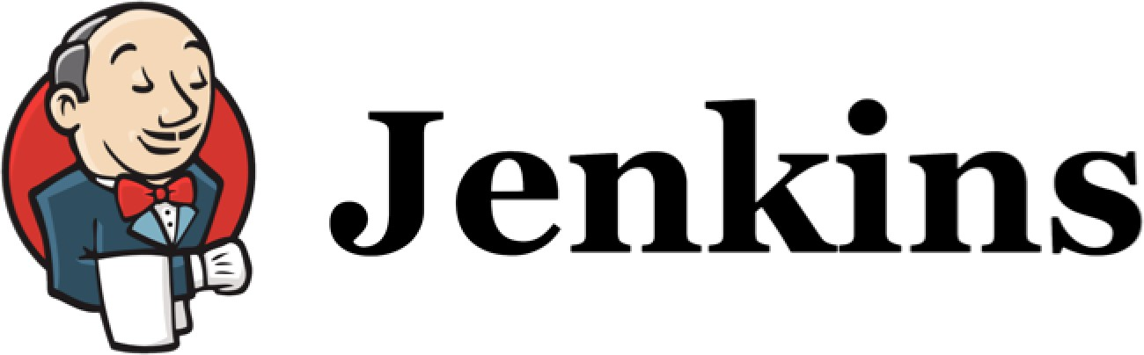
Continuous Integration

Slide 2
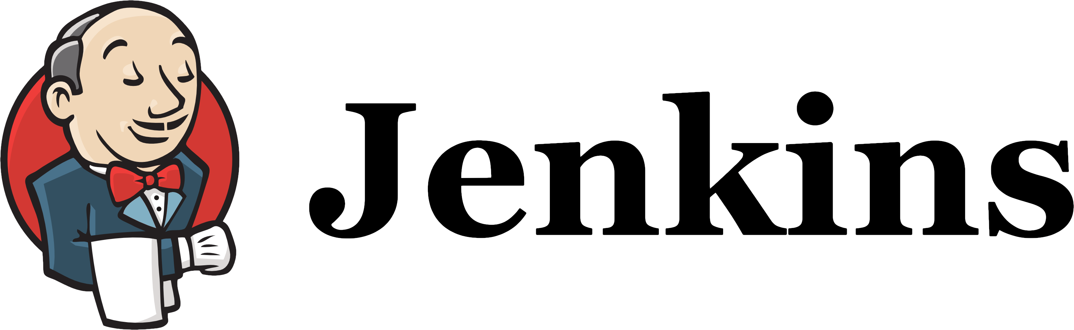
Continuous Integration
What is Continuous Integration?
Why do we need it?
Different phases of adopting Continuous Integration

Slide 3
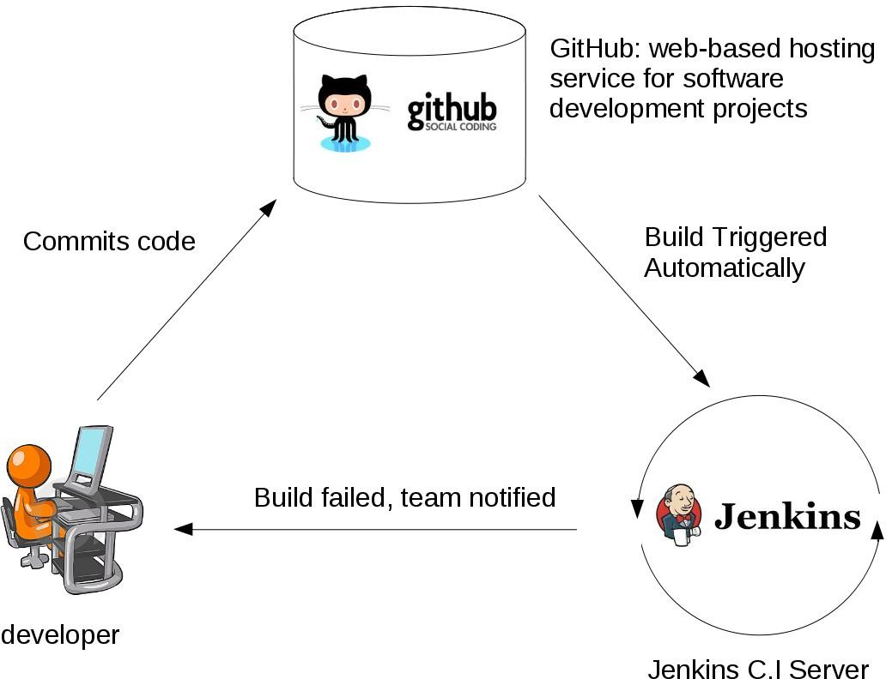
What is Continuous Integration?
Developers commit code to a shared repository on a regular basis.
Version control system is being monitored. When a commit is detected, a build will be triggered automatically.
If the build is not green, developers will be notified immediately.

Slide 4
Why do we need Continuous Integration?
Detect problems or bugs, as early as possible, in the development life cycle.
Since the entire code base is integrated, built and tested constantly , the potential bugs and errors are caught earlier in the life cycle which results in better quality software.

Slide 5
Different stages of adopting Continuous Integration

Slide 6

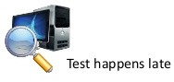


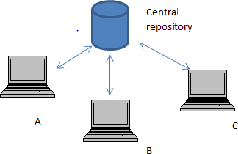
Stage 1:
No build servers.
Developers commit on a regular basis.
Changes are integrated and tested manually.
Fewer releases.
Few commits

Slide 7
Stage 2:
Automated builds are scheduled on a regular basis.
Build script compiles the
application and runs a set of automated tests.
Developers now commit their
changes regularly.
Build servers would alert the
team members in case of build failure.
Build nightly
Build and run tests

Slide 8
Stage 3:
Triggered
A build is triggered whenever
atomically
new code is committed to the central repository.
Broken builds are usually treated as a high priority issue and are fixed quickly.
Build and run tests

Slide 9
Stage 4:
Triggered
Automated code quality and code coverage metrics are now run along with unit tests to continuously evaluate the code quality.
atomically
Is the code coverage increasing?
Do we have fewer and fewer build failures?
Build, run code quality and code coverage metrics along with tests

Slide 10
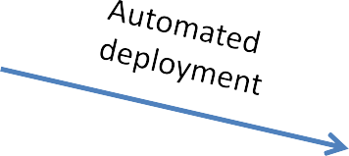

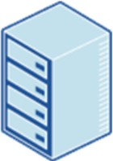
Stage 5:
Triggered
Automated Deployment
atomically
Production

Slide 11
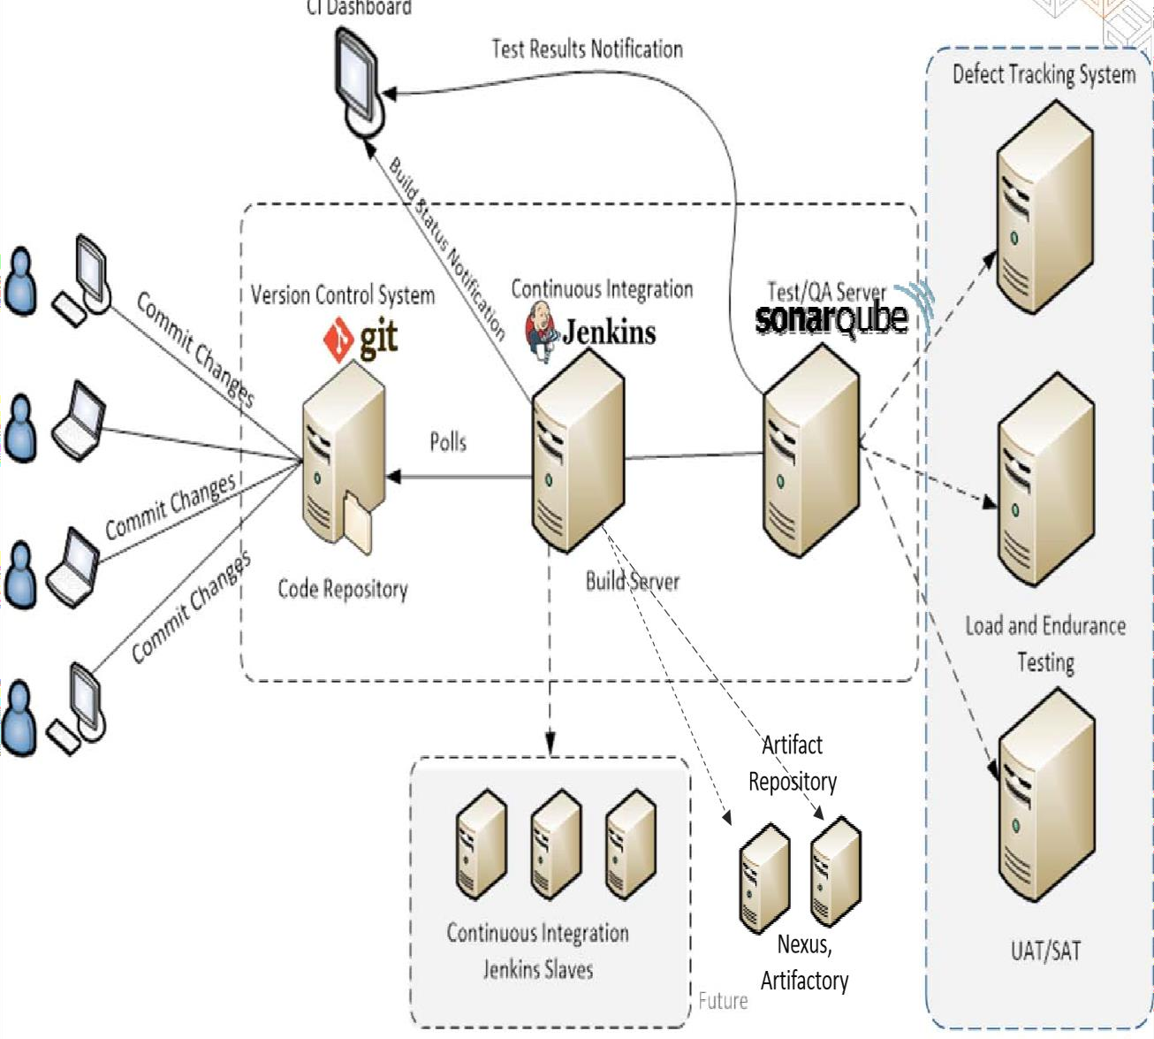

CI/CD Environment

Slide 12
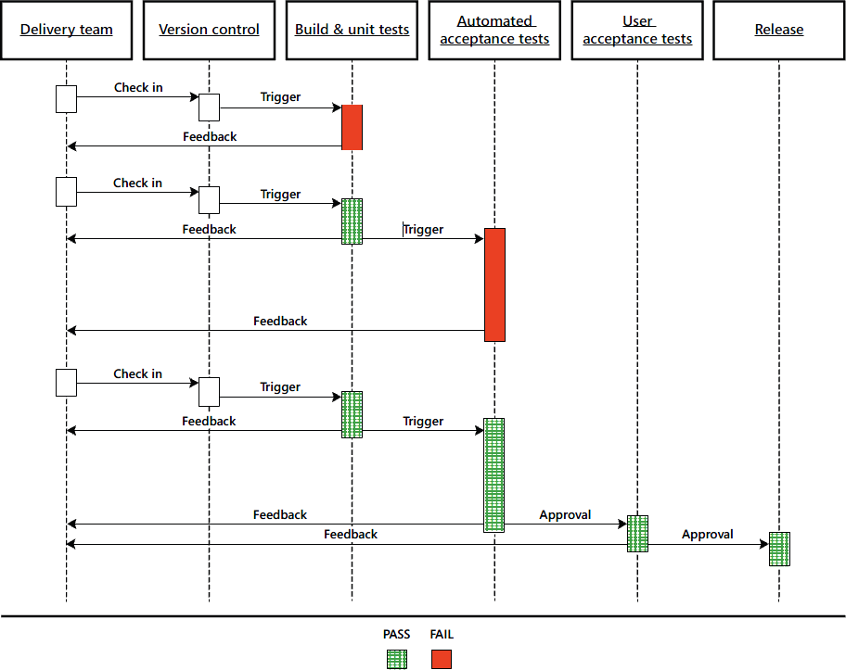

Slide 13
Continuous Integration Continuous Delivery Continuous Deployment

Slide 14
Continuous Integration
The practice of merging development work with the main branch constantly.
Continuous Delivery
Continual delivery of code to an environment once the code is ready to ship. This could be staging or production. The idea is the product is delivered to a user base, which can be QAs or customers for review and inspection.
Continuous Deployment
The deployment or release of code to production as soon as it is ready.

Slide 15
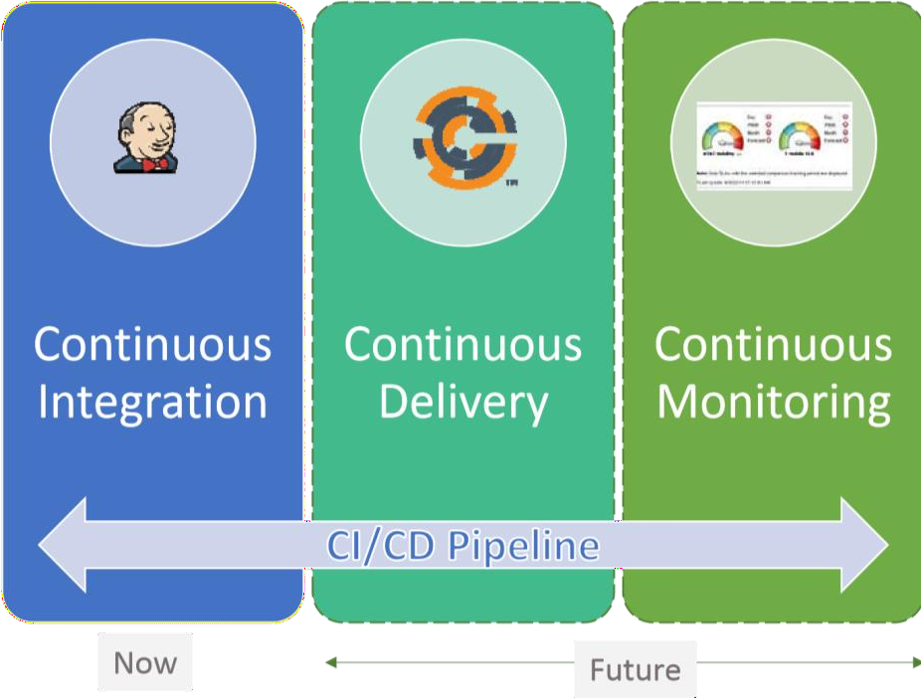
DevOps
Deployment

Slide 16
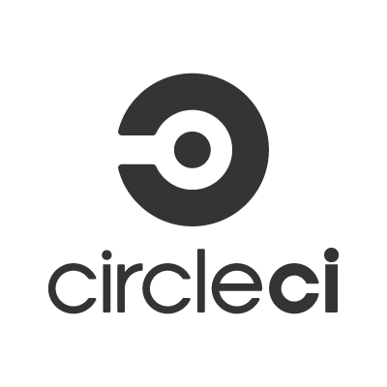

How to implement Continuous Integration?
Non-hosted solutions
Hosted solutions

Slide 17
Continuous Integration is also a mindset
Fixing broken builds should be treated as a high priority issue for all team members.
The deployment process should be automated, with no manual steps involved.
All team members should focus on contributing to high-quality tests because the confidentiality of the CI process highly depends on the quality of the tests.

Slide 18
What is Jenkins
Jenkins is a continuous integration and build server.
It is used to manually, periodically, or automatically build software development projects.
It is an open source Continuous Integration tool written in Java.
Jenkins is used by teams of all different sizes, for projects with various languages.

Slide 19
Why Jenkins is popular
Easy to use
Great extensibility
Support different version control systems
Code quality metrics
Build notifiers
UI customization

Slide 21
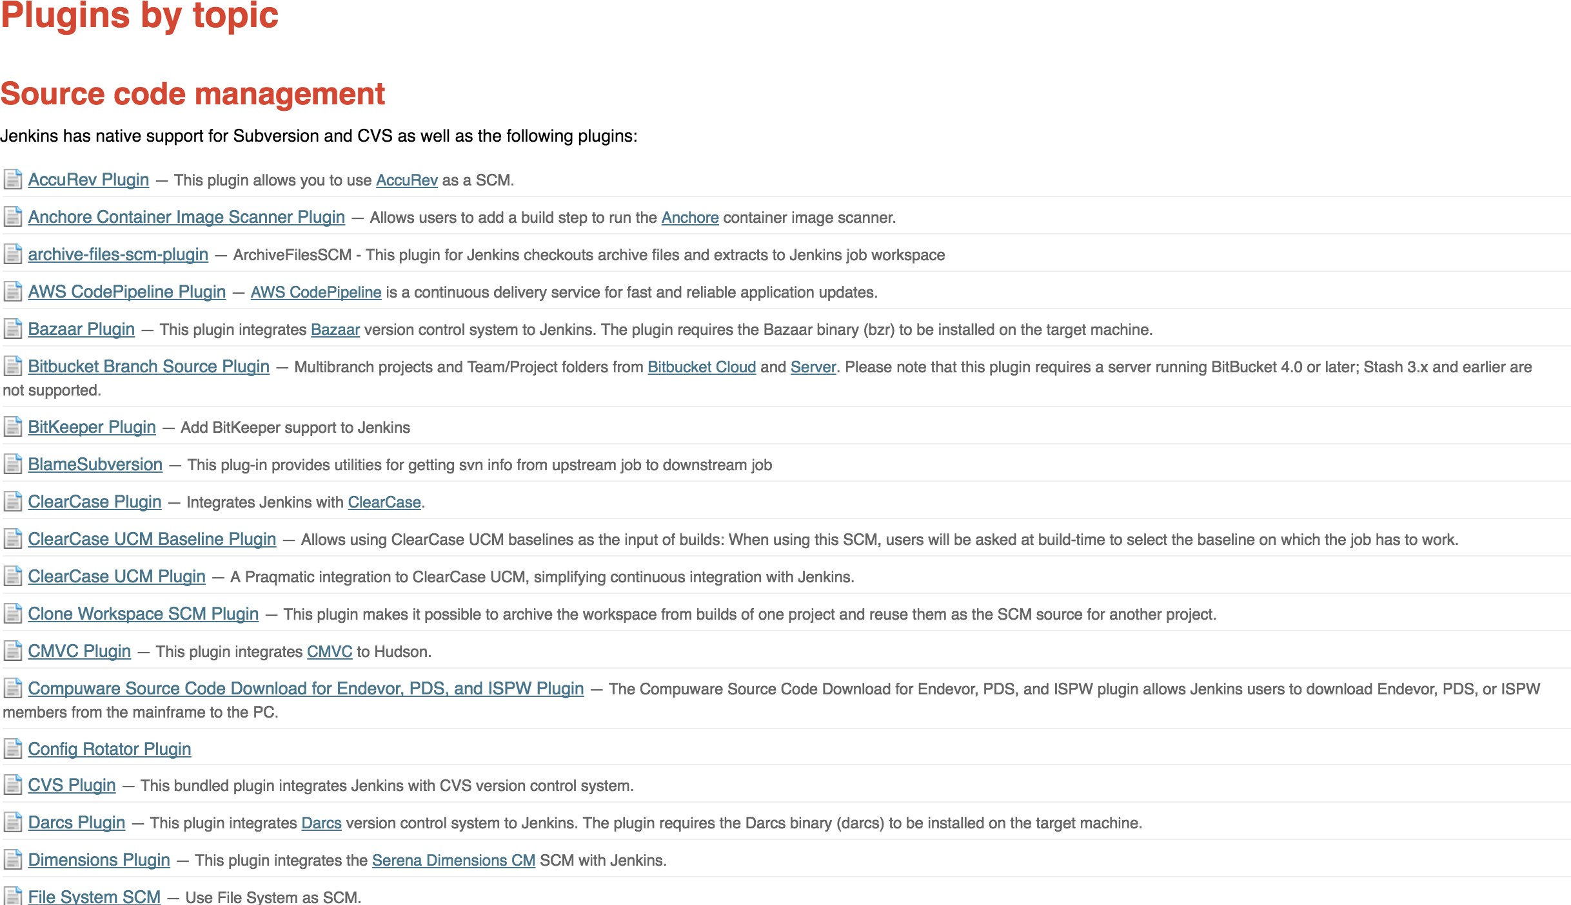

Slide 22
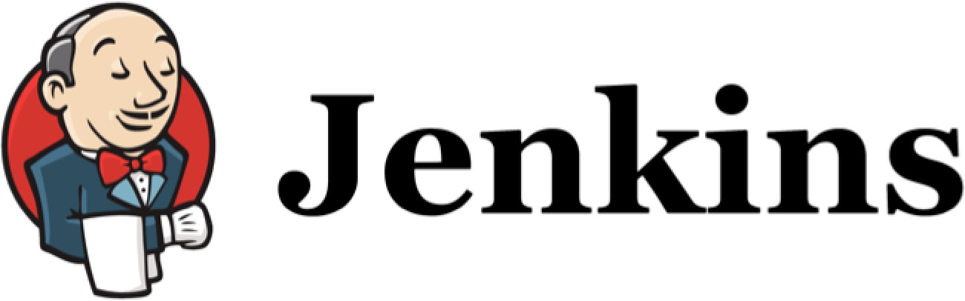
Jenkins’ Master and Slave Architecture
Some Important Jenkins’ Terminologies

Slide 23
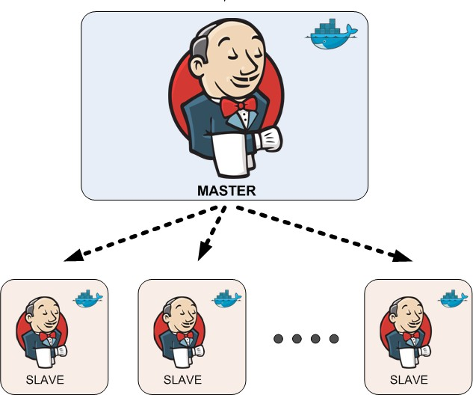
Jenkins’ Master and Slave Architecture
Master:
Schedule build jobs.
Dispatch builds to the slaves for the actual job execution.
Monitor the slaves and record the build results.
Can also execute build jobs directly.
Slave:
Execute build jobs dispatched by the master.

Slide 24
Jenkins UI Overview

Slide 25
Install GIT and GitHub plugin

Slide 26
Install and Configure Maven

Slide 27
What does Maven do?
Maven describes how the software is built.
Maven describes the project’s dependencies.

Slide 28


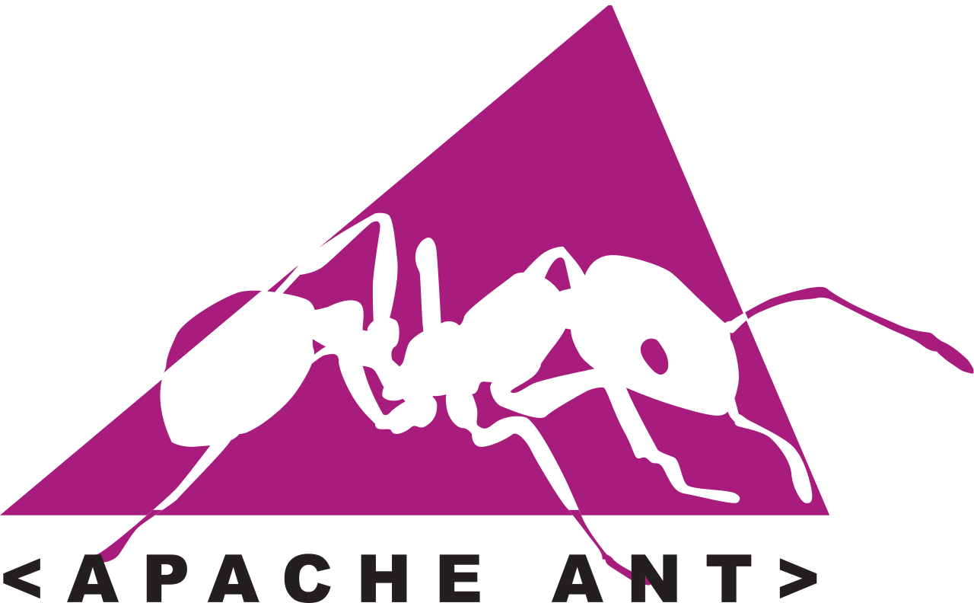
Java Build Tools

Slide 29
Configure Jenkins for a Maven -based project

Slide 30
Create a Maven -based Jenkins project

Slide 31
Run Maven-based Jenkins project

Slide 32
Maven pom.xml file
Describe the software project being built, including
The dependencies on other external modules.
The directory structures.
The required plugins.
The predefined targets for performing certain tasks such as compilation and packaging.

Slide 33
Different Phases in Maven Build Lifecycle
validate Validate the project is correct and all necessary information is available.
compile test
Compile the source code of the project.
Test the compiled source code using a suitable unit testing framework.
package Take the compiled code and package it in its distributable format.
verify install
Run any checks on results of integration tests to ensure quality criteria are met. Install the package into the local repository, for use as a dependency in other projects locally.
Copy the final package to the remote repository for sharing with other developers and projects.
deploy

Slide 34
Maven Build Phases
These lifecycle phases are executed sequentially to complete the default lifecycle.
We want to specify the maven package command, this command would execute each default life cycle phase in order including validate, compile, test before executing package.
We only need to call the last build phase to be executed.

Slide 35
Jenkins code quality metrics report

Slide 36
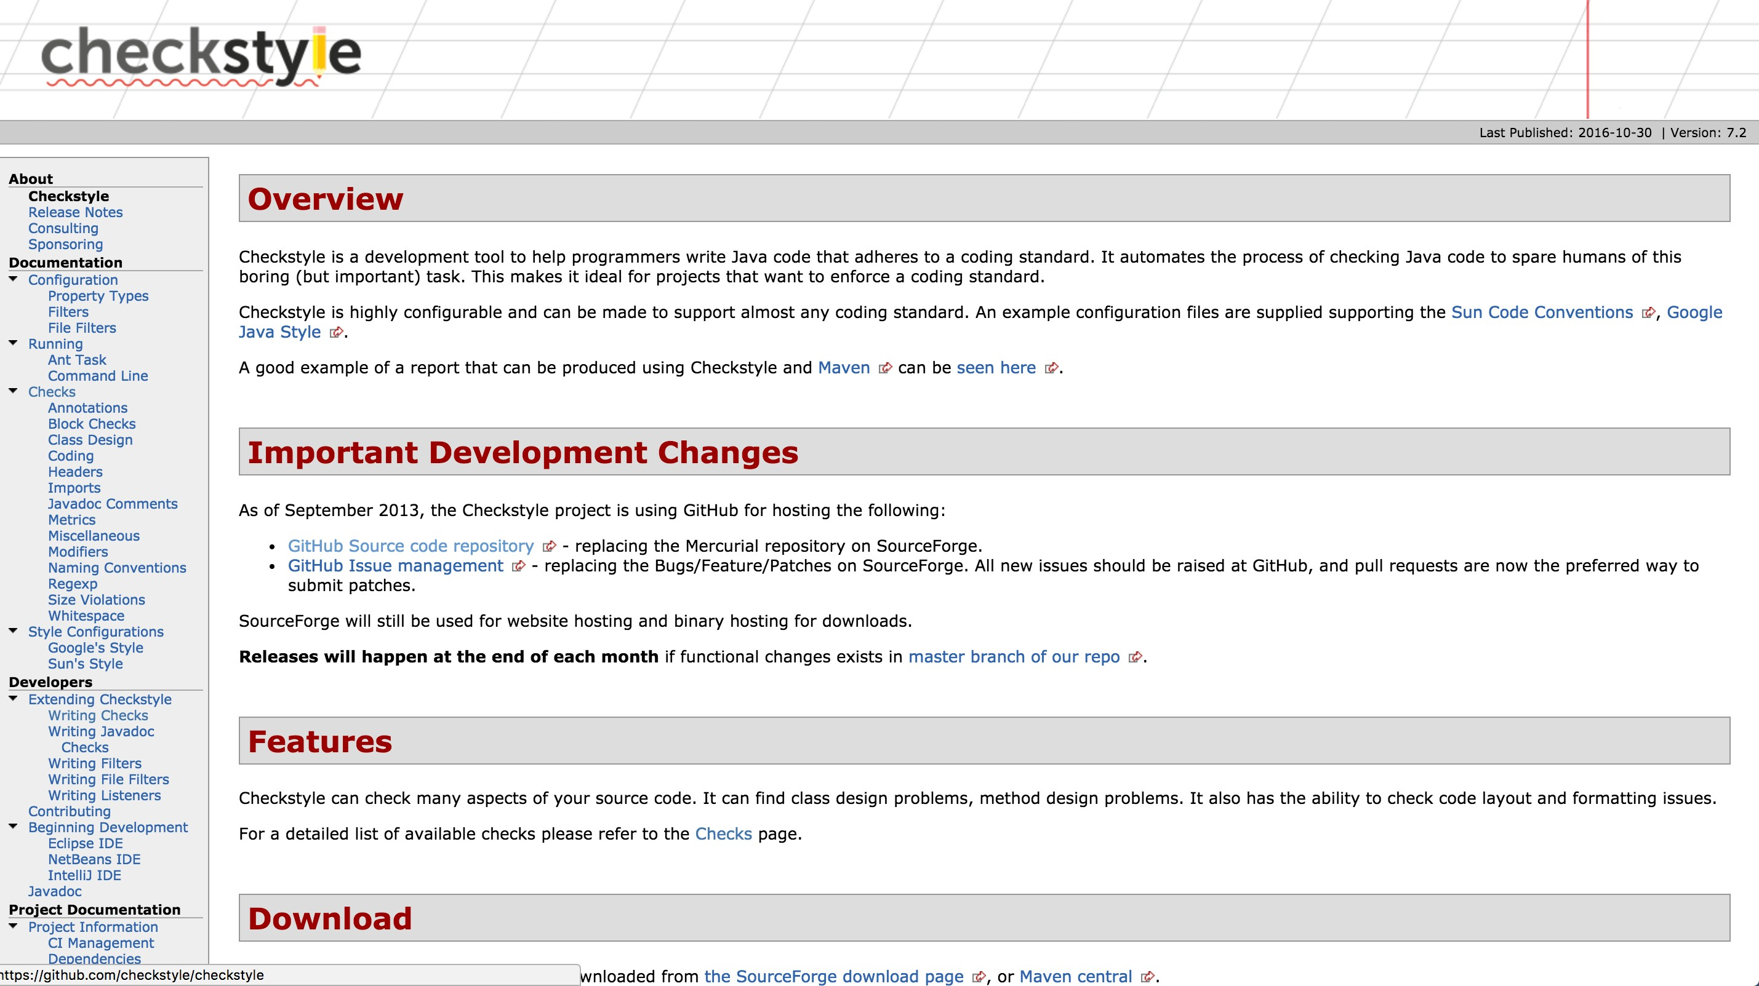
Checkstyle is a code static analysis tool to help programmers to write Java code that adheres to a coding standard such as
Avoiding multiple blank lines;
Removing unused variables;
Enforcing correct indentations;
…

Slide 37
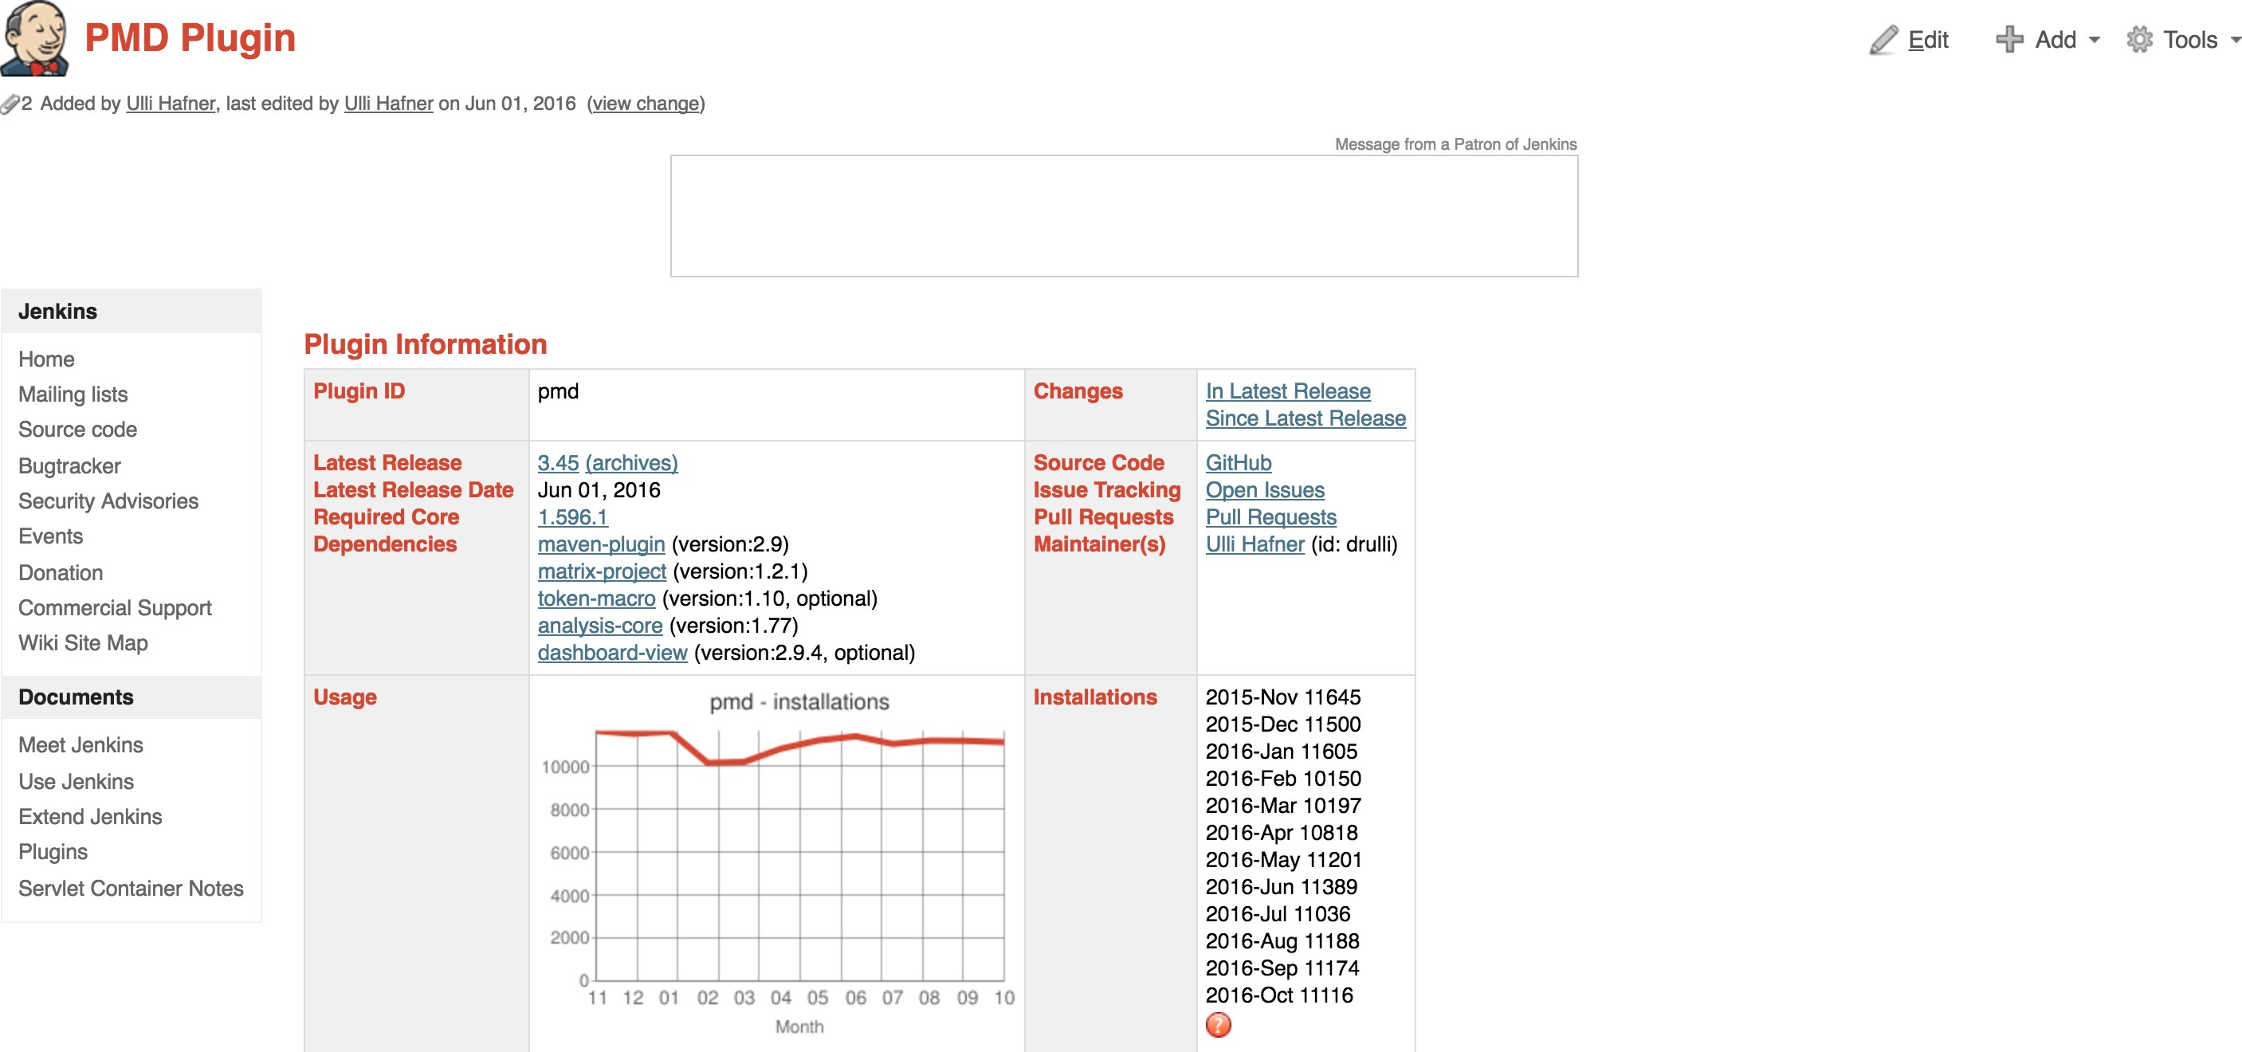
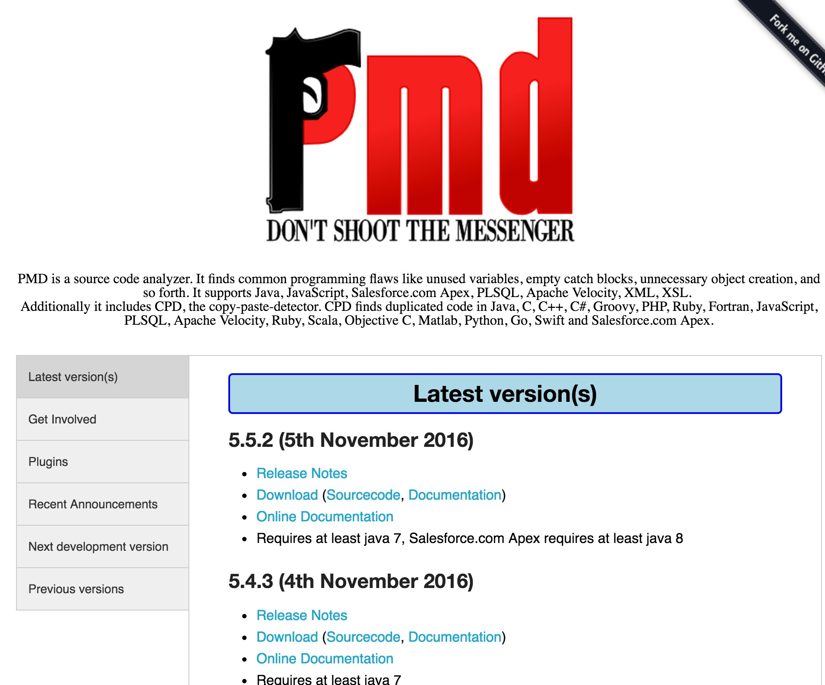

Slide 38
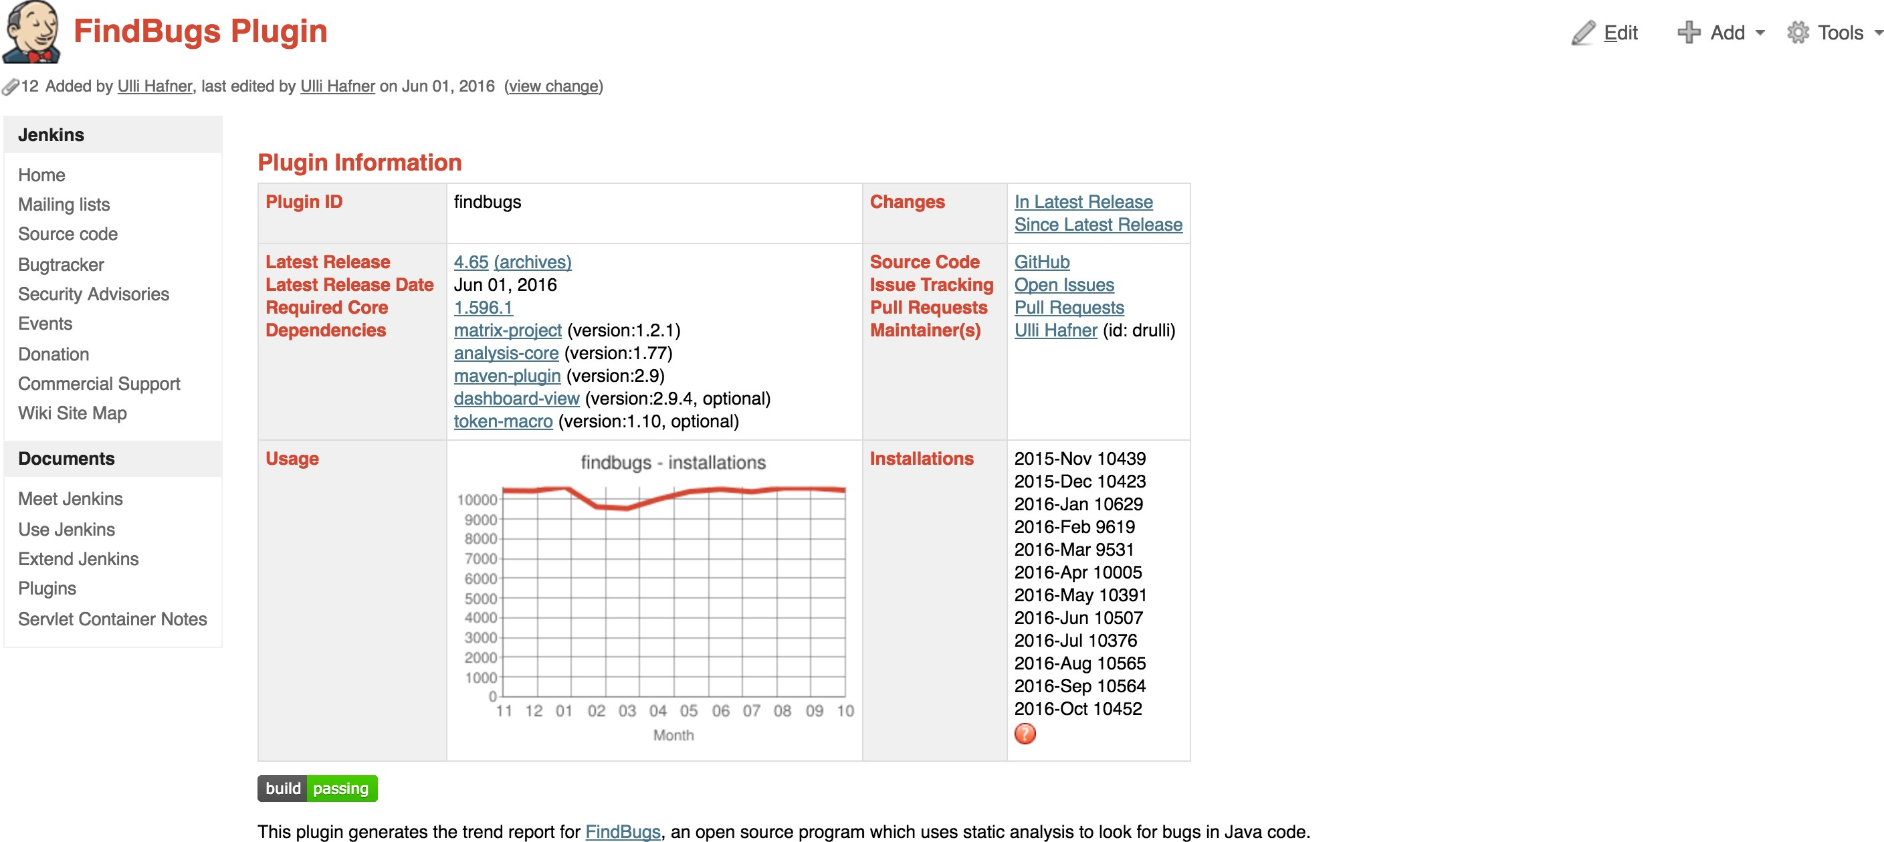

Slide 39
Jenkins’ support for other build systems (Ant, Gradle and shell scripts)

Slide 40

Apache Ant
Widely-used and very well-known build scripting language for Java.
Flexible, extensible, relatively low-level scripting language.
An Ant build script is made up of a number of targets, each target performs a particular job in the build process.

Slide 41
Gradle
Gradle is a relatively new open source build tool for the Java Virtual Machine.
Build scripts for Gradle are written in a Domain Specific Language based on Groovy.
The concise nature of Groovy scripting lets you write very expressive build scripts with very little code.

Slide 42
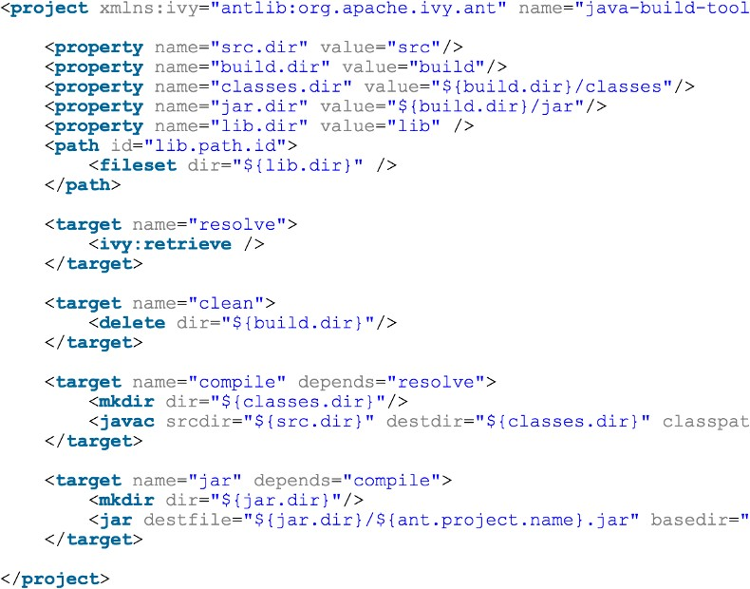
Build Scripts
Maven Build Script
\

Slide 43
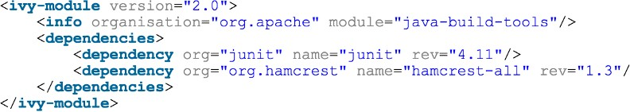
Gradle Build Script
Ant Build Script Sample

Slide 44
Install and configure Tomcat as a staging environment

Slide 45

Tomcat
Tomcat is an open-source web server and provides a "pure Java” HTTP web server environment in which Java code can run.

Slide 46
Install copy artifact and deploy to container plugins
Deploy our application to staging environment

Slide 47
Jenkins Build Pipeline

Slide 48
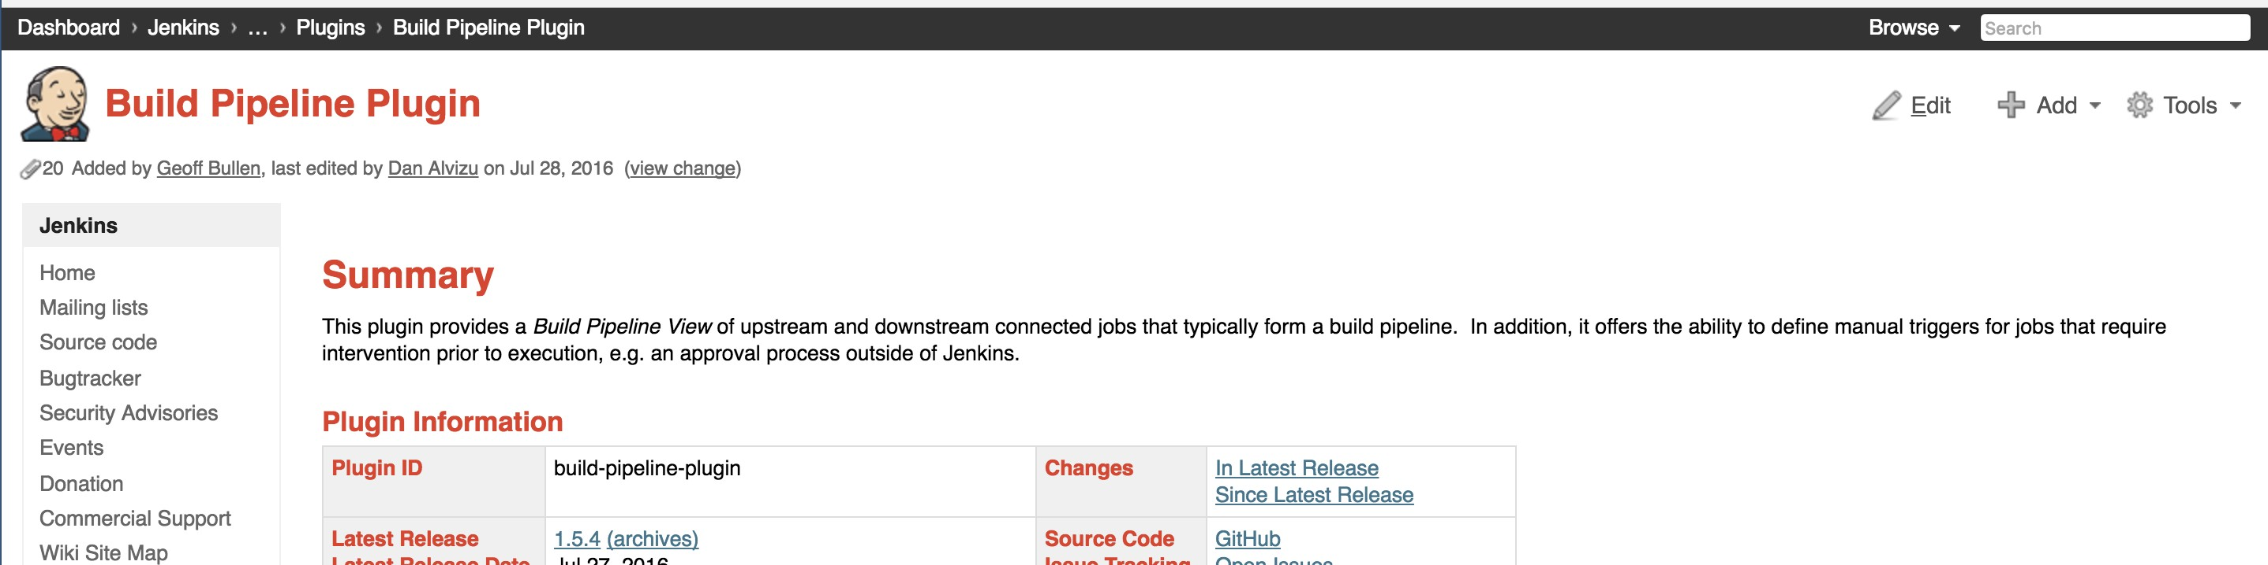
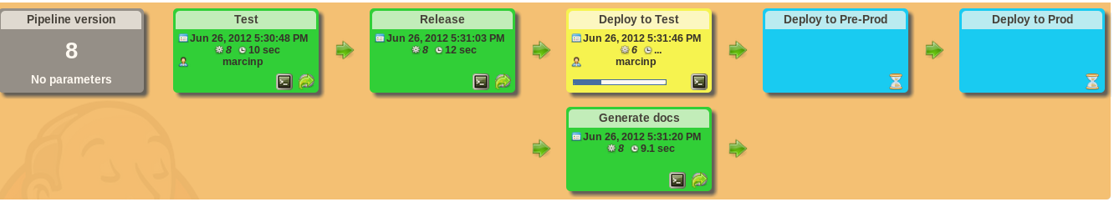
Build Pipeline Plugin

Slide 49
Parallel Jenkins Build

Slide 50
Continuous Delivery
Deploy our app to production

Slide 51
Benefits of a code-based pipeline
Version control
Best Practices
Less error-prone execution of jobs
Logic-based execution of steps

Slide 52
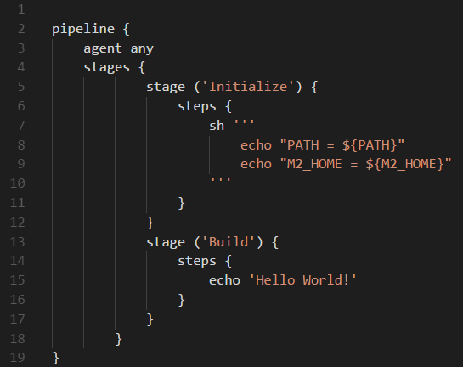
Sample Jenkinsfile

Slide 53
Additional automation
Setup Git repository polling
Deployment to our tomcat servers
We will setup tasks to run in parallel

Slide 54
Steps
Step 1: Configure securit groups for Tomcat servers and create key pairs.
Step 2: Provision instances to staging and production
environments.
Step 3: Install and run Tomcat on created instances.
Step 4: Fully automate our existing Jenkins pipeline.

Slide 55
Introduction to Distributed Jenkins Builds

Slide 56
Install Jenkins Master in the Cloud

Slide 57
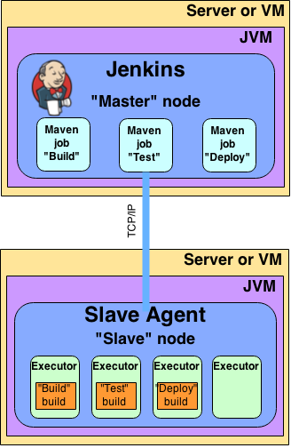
Jenkins Slave Agent

Slide 58
Install Jenkins slaves in the cloud and form a Jenkins cluster

Slide 59
Concurrent Builds on Jenkins Cluster Label Jenkins Nodes

Slide 60
Build Orchestration: Jenkins
Continuous integration system
Enable automated build and test process
Can monitoring executions of externally‐run jobs, such as cron jobs and procmail jobs…
Dependency tracking, allowing file finger printing and tracking for example which build is using which version of jars…
Generates list of changes made to build from Subversion
Distributed build/test
Jenkins is a build orchestration, CI software
building/testing software projects continuously
monitoring executions of externally‐run jobs
FishEye allows you to extract information from your source code repository and display it in sophisticated reports.
Crucible allows you to request, perform and manage code
reviews.
Subversion centralized version control system
Sonar is a quality management platform for analyzing and measuring source code quality.

Slide 61









CI/CD Pipeline: Functional Architecture
Fail
Fail
Fail
Not approved
Automated Test
Staging
Develop
Pre-commit Tests
Commit code to Version Control 5
System
CI polls VCS
UAT
SAT
2
3
and creates Buil⁷
9
Release
Security Scan Perf. & Load Testing
1
4
6
8
Version Control System Code Repository |  | Artifact Repository (Artifactory) |  | Build Management (Maven) |  | Build Automation (Jenkins) |  | Test Automation QA (SonarCube) |  | Release Orchestration |  | Deployment Automation

Slide 62
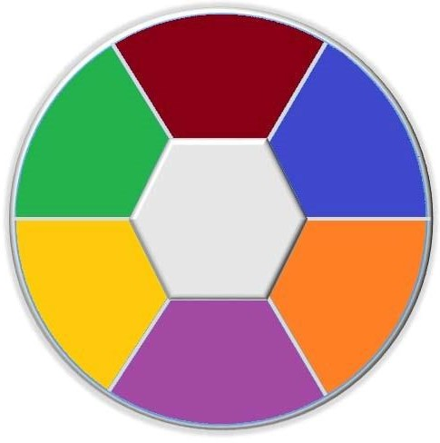
An Automated, Integrated and End to Ent CCRM
Git, GitLab, GitHub Enteprise,
SVN…
Source Code Management (Version Control)
Maven, Ant, Gradle
Release Management
Build Automation
CCRM
Environment Configuration Management
Nexsus, Artifactory
CI/CD
Jenkins…
Test Automation
Junit, Test NG, Cucumber, Selenium, JMeter, SoapUI, LoadRunner…

Slide 63
